Slide 1
Koh Jing Yu
Wu Shang Jing
Zhou Peizhang
Samuel Halim
Caleb Ng

Slide 2
THE GOAL
Introduce simple gardening to communities
Educate people about green living / organic farming
Incentivise green behaviour

Slide 3
CURRENT SOLUTIONS
PROBLEMS
Very individualistic task
Generally not automated
Difficult to moderate water and nutrients for plants
Requires constant care
Small personal hydroponic plant pots
DIY home gardening kits

Slide 4
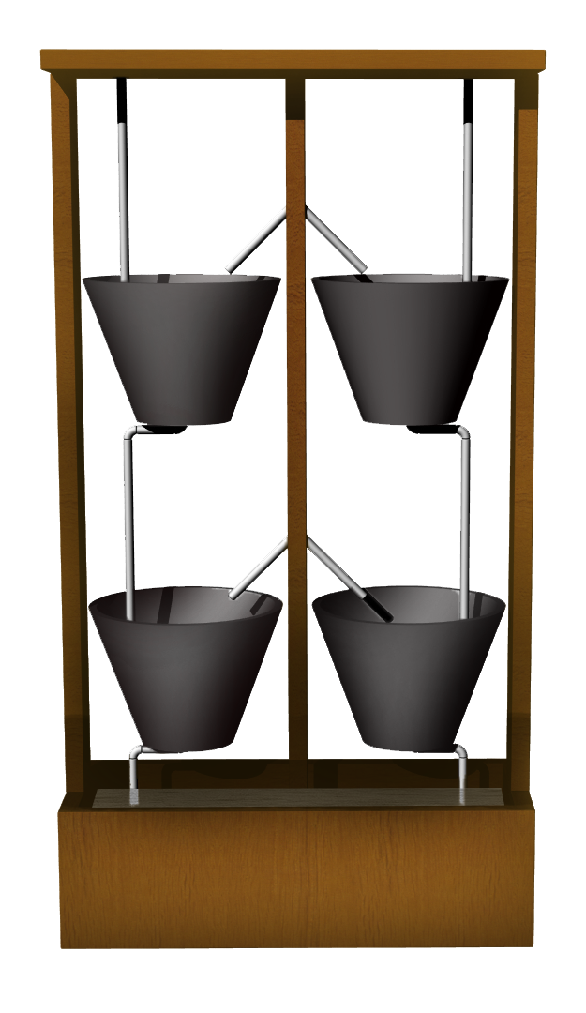
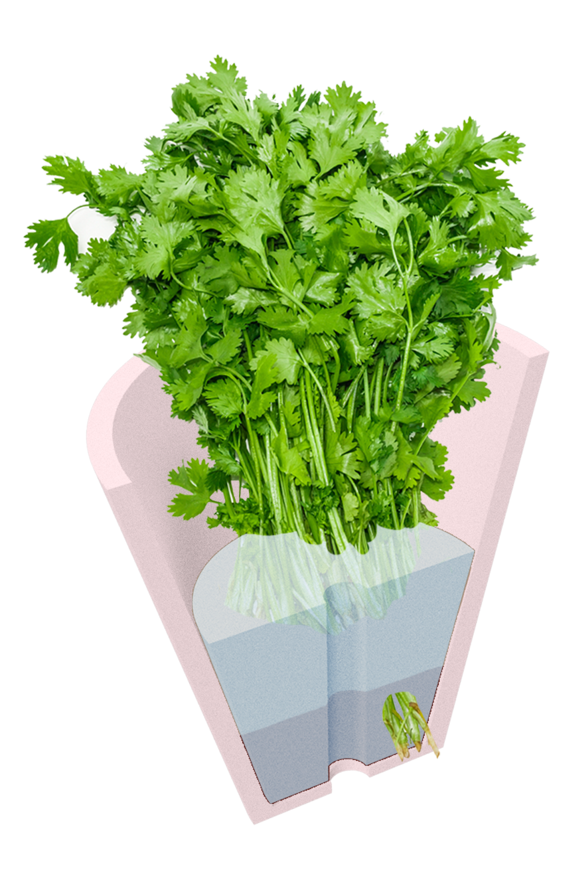
THE PLAN(T)
Vertical farming wall
Modular plant pots
Plants are given statistics
Sensors involved: Light, humidity, temperature
Actuators: Water pumps

Slide 5
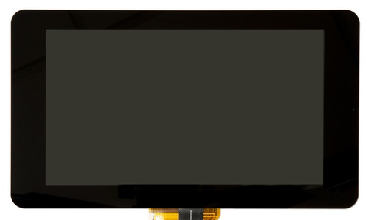
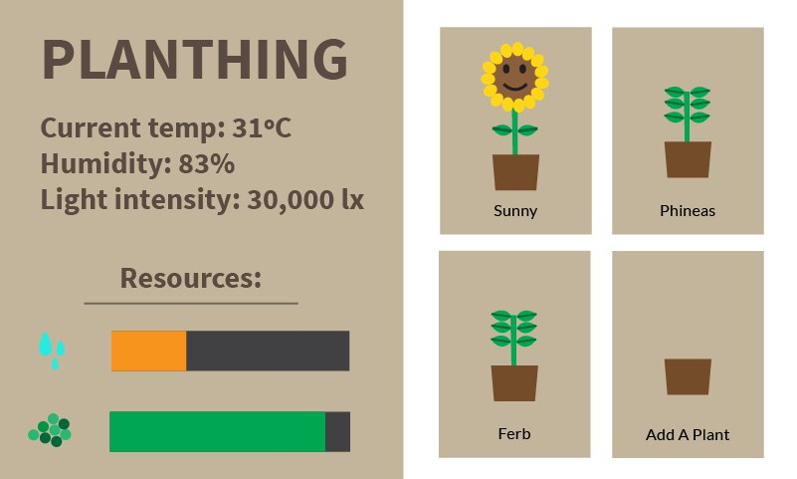
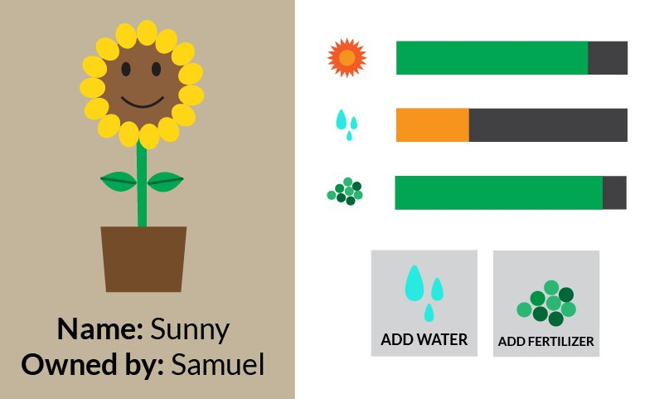

Slide 6
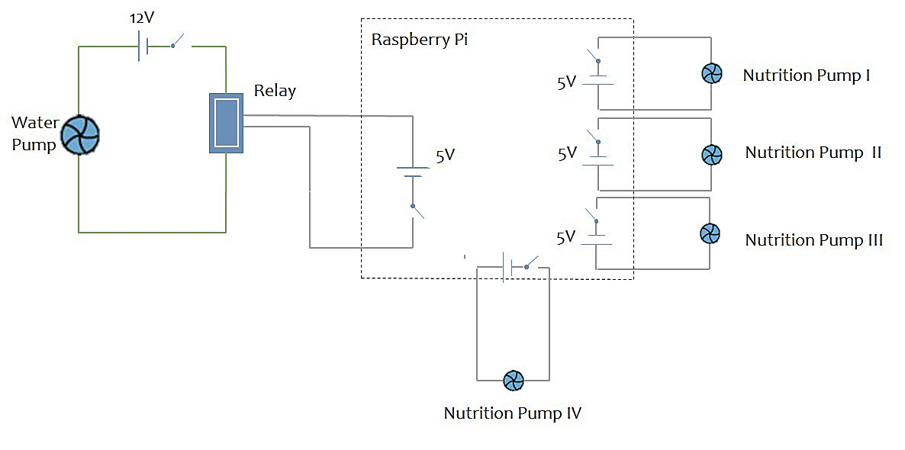
THE TOOLS
Sensors
Humidity Sensor
Light Sensor
Temperature Sensor
Actuator(s)
Water Pump
Others
Raspberry Pi
Tubes
Wood Frame

Slide 7
BUDGET ($50)
Item | Price
Water Pump
Small Pump | S$0.7157 * 4 = S$2.86
Big Pump | S$4.6052
Temperature Sensor | S$1.23
Humidity Sensor
Air Humidity | S$0.88
Light Sensor | S$1.23
Tubes (per metre) | S$0.7103 * 3 = S$2.13
Plants | S$3 * 4 = S$12
Wooden Frame | S$10
Electronic Components | Recycle (Free)
TOTAL | S$34.93

Slide 8
TIMELINE AND ROLES
 | Week 6 | Week 7 | Week 8 | Week 9 | Week 10 | Week 11 | Week 12 | Week 13
Jing Yu | MATERIALS | MATERIALS | PROTO | PROTO | CODE | TEST/MOD | PROTO | PRESENT
Shang Jing | FRAME | FRAME | PROTO | CODE | TEST/MOD | CODE | PROTO | PRESENT
Samuel | FRAME | FRAME | PROTO | CODE | TEST/MOD | CODE | POSTER | PRESENT
Pei Zhang | MATERIALS | MATERIALS | PROTO | CODE | CODE | POSTER | POSTER | PRESENT
Caleb | MATERIALS | MATERIALS | PROTO | PROTO | CODE | POSTER | POSTER | PRESENT
Deliverables (who is in charge of deadlines)
Physical Prototype | Shang Jing, Samuel
Poster | Jeremy, Caleb
Code (GUI) | Jing Yu

